Slide 1

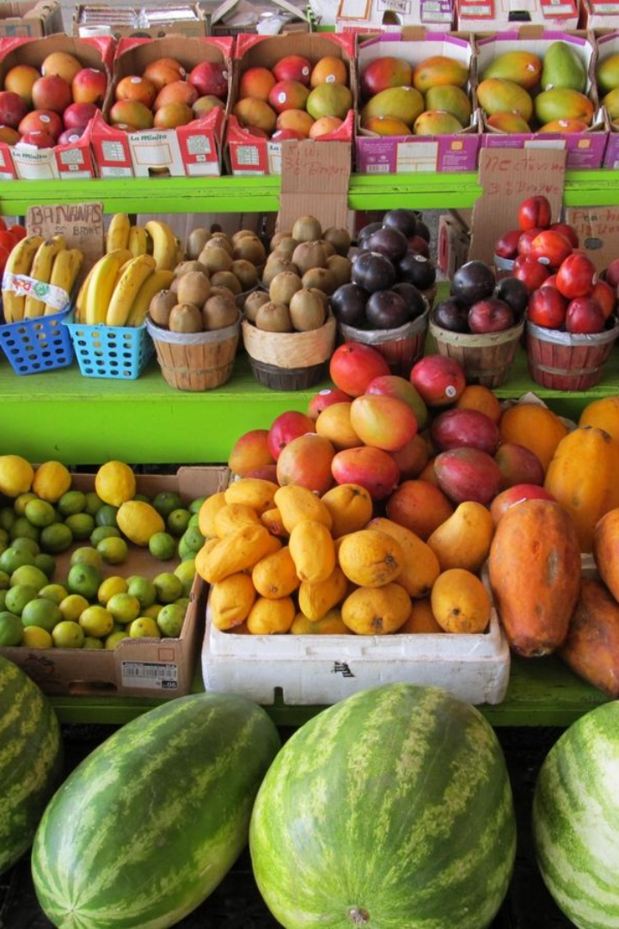
Welcome to our Store Flavor
Welcome to our online store, where you'll find the freshest and highest quality fruits, vegetables, and spices. We take pride in providing a wide variety of fresh produce to our customers.

Slide 2
Explore Our Product Categories
Fruits 🍎
Vegetables 🥕
Spices 🌶️
From juicy apples to tropical bananas, we offer a diverse range of flavorful fruits.
Discover a colorful assortment of farm-fresh vegetables, perfect for your culinary creations.
Enhance the flavors of your dishes with our premium collection of aromatic spices and seasonings.

Slide 3
Browse Our Variety and Quality
1
Extensive Selection
2
Farm-Fresh Quality
3
Seasonal Specials
Check out our seasonal offerings for delightful surprises and the best produce each season has to offer.
Explore a wide range of fruit varieties, vegetable types, and flavorful spices to suit every taste and recipe.
Our products are meticulously selected to ensure freshness, quality, and nutritional value for our customers.

Slide 4
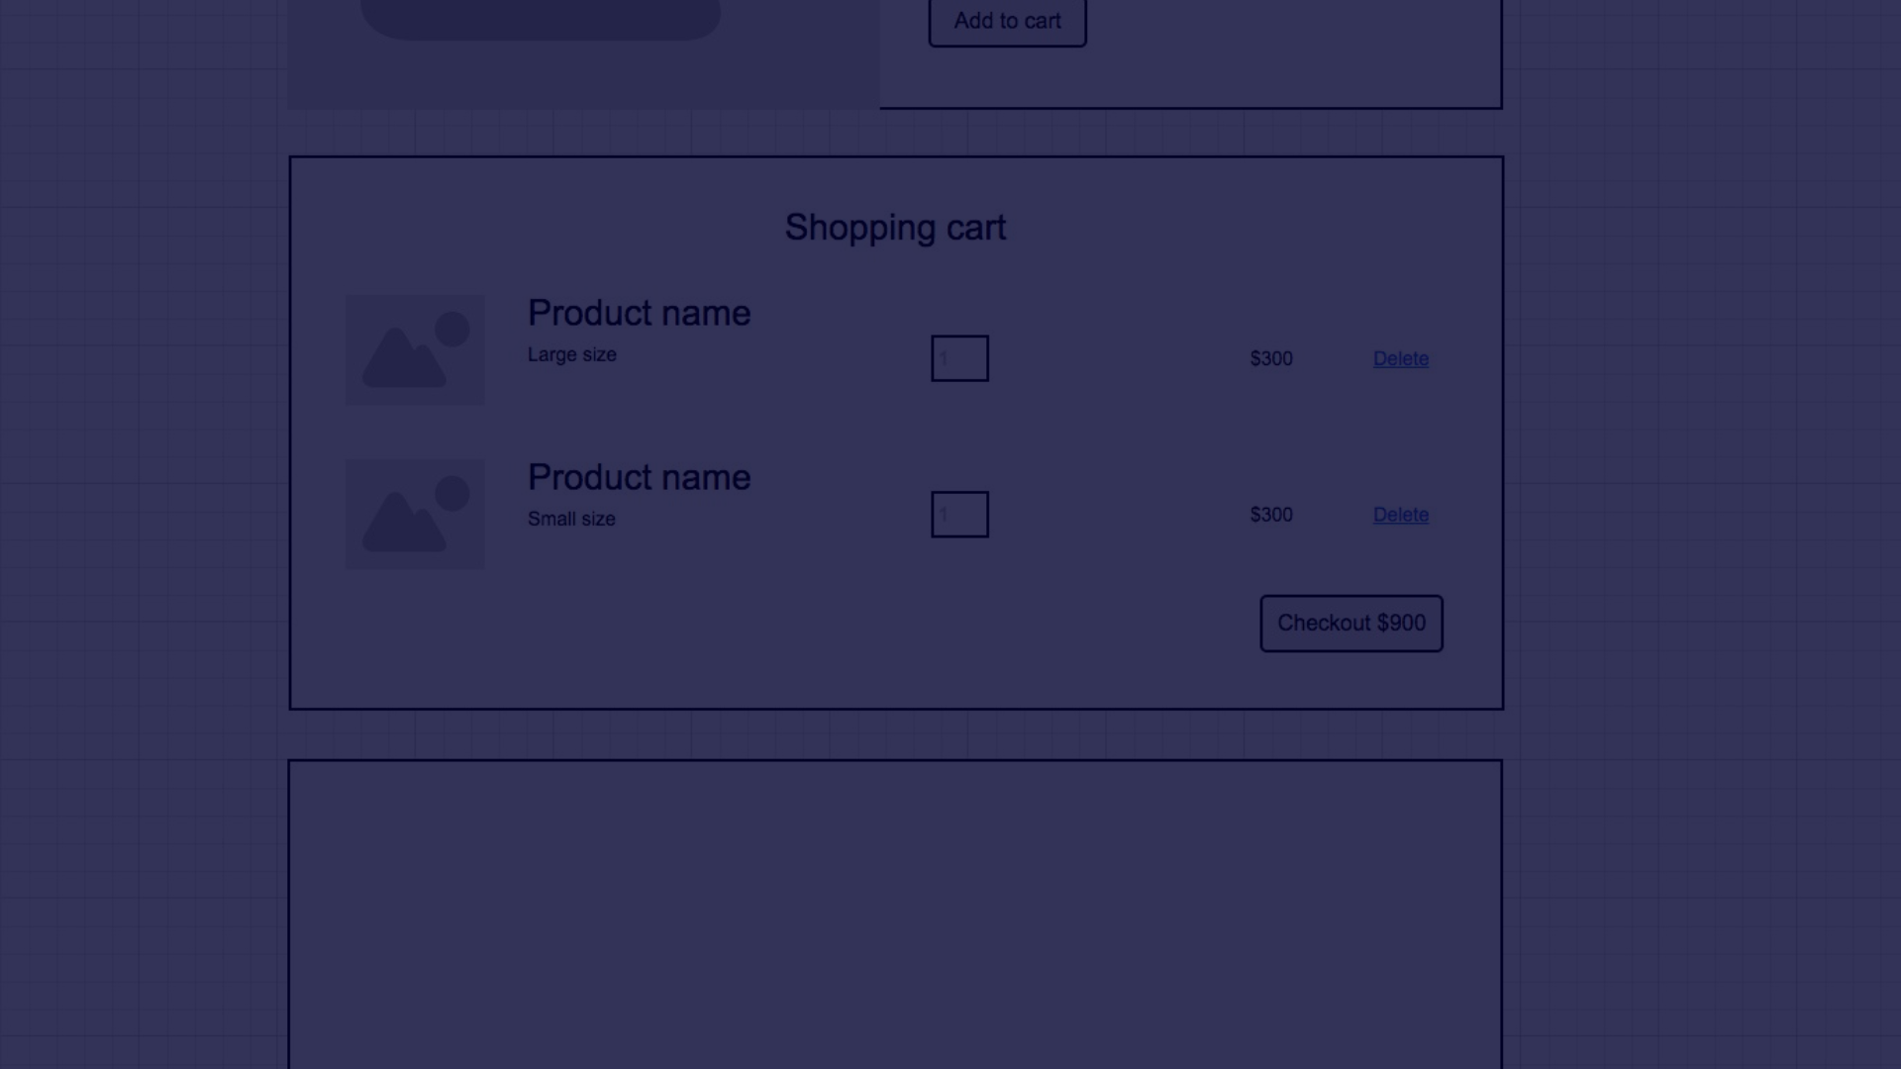
Convenient Shopping Cart and Checkout
Seamless Shopping Experience
Express Checkout
Order Tracking
Save time with our efficient express checkout feature for swift and hassle-free purchases.
Stay updated with real-time tracking of your order from checkout to delivery at your doorstep.
Effortlessly add your favorite items to the cart and proceed through the secure checkout process with ease.

Slide 5
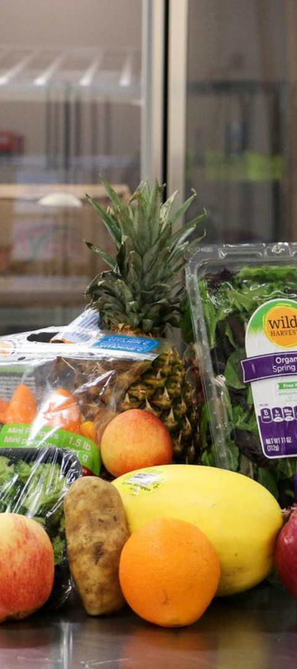



Secure Payment Options
Variety of Options
Choose from diverse and secure payment methods, ensuring safe and hassle-free transactions.
Encryption Technology
Your payment information is protected with advanced encryption, guaranteeing the utmost security and privacy.
Trusted Partnerships
We've partnered with reputable and trusted payment gateways to ensure a secure and trustworthy payment process.

Slide 6
Delivery and Shipping Information
Fast Delivery
Count on swift and reliable delivery services to get your fresh produce to your door without delay.
Shipping Options
Choose from a range of shipping options, including express shipping for urgent orders.
Delivery Tracking
Track your delivery every step of the way, ensuring peace of mind and convenience.

Slide 7
Customer Reviews and Ratings
4.8
500
Outstanding Ratings
Rave Reviews
Our exceptional customer satisfaction is reflected in the outstanding average rating of 4.8 out of 5.
Join over 500 satisfied customers who have shared their positive experiences with our fresh produce.

Slide 8

Get in Touch
1
Customer Support
Our dedicated customer support team is available to assist you with any queries or concerns, offering prompt solutions.
2
Contact Options
Reach out to us via phone, email, or live chat for quick and personalized assistance.
3
Feedback Welcome
We value your feedback and are always eager to hear from our customers to enhance your shopping experience.

